Slide 1
NIH STRIDES Initiative Overview and Cloud Platforms & Services at NIH PEARC20 Workshop: Facilitation Strategies and Experiences for Research Use of Cloud Computing
Nick Weber
Program Manager, Cloud Services | NIH STRIDES Initiative
National Institutes of Health (NIH) Center for Information Technology (CIT)
Joel Peterson
Cloud Architect | NIH/CIT Cloud Services & NIH STRIDES Initiative
National Institutes of Health (NIH) Center for Information Technology (CIT)
July 26, 2020

Slide 2
The Cloud Can Greatly Benefit (Some Types of) Research…
Always available, on-demand
Pay as you go, for only what you use
Scales up and down easily
Test and iterate
A rich and ever-growing set of tools and services

Slide 3
…But Getting There Can Be Difficult
When NIH Institutes and Centers want to get access to the cloud for intramural researchers, a host of complexities arise:
Setting up acquisition vehicles
Budgeting and paying for usage
Growing, securing, and maintaining prototype capabilities as more robust infrastructure, systems, and services
For NIH’s extramural research programs, there are both similar and different complications:
Budgeting for cloud in grants, including navigating direct versus indirect cost questions and inconsistencies
Reconciling challenges with among cloud credits, individual/departmental/institutional payment, and payment via funding-institution-led programs
Understanding expectations for researchers/institutions around information security of federally-funded systems

Slide 4
Strategic Plan for Data Science: Goals and Objectives
Data Infrastructure
Connect NIH data systems
Modernized Data Ecosystem
Modernize data repository ecosystems
Support storage and sharing of individual datasets
Data Management, Analytics, and Tools
Support useful, generalizable, and accessible tools
Broaden utility of, and access to, specialized tools
Better integrate clinical and observational data into biomedical data science
Workforce Development
Improve discovery and cataloging resources
Enhance the NIH data science workforce
Develop policies for a FAIR data ecosystem
Expand the national research workforce
Engage a broader community
Stewardship and Sustainability
Enhance stewardship
Optimize data storage and security

Slide 5
The NIH STRIDES Initiative

Slide 6



Turning Research Data Into Knowledge and Discovery
The Science and Technology Research Infrastructure for Discovery, Experimentation, and Sustainability (STRIDES) Initiative
State-of-the-art data storage and computational capabilities
Training and education for researchers
Innovative technologies such as artificial intelligence and machine learning
https://datascience.nih.gov/strides
,
Partnerships with
,
and other commercial providers

Slide 7
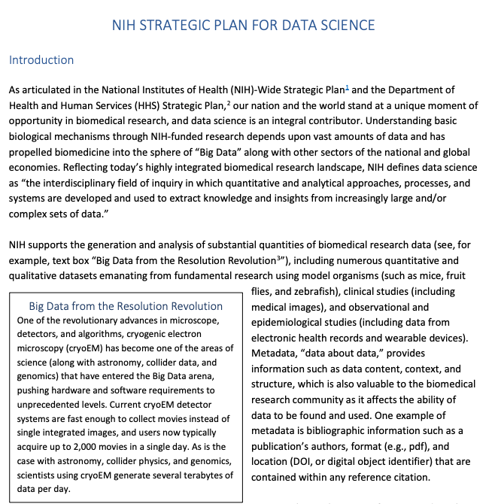
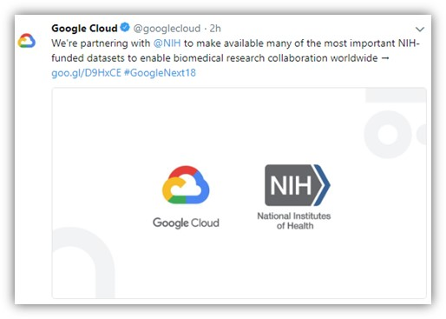
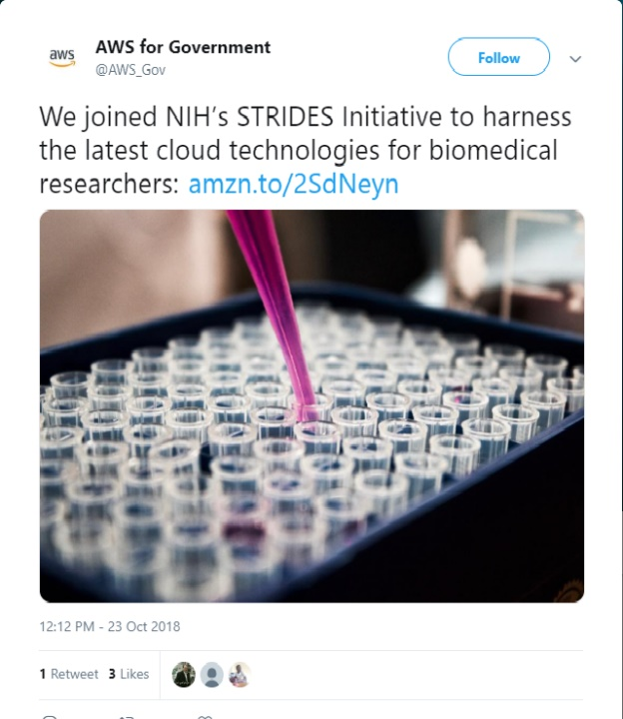
STRIDES Partnerships
“NIH must weave its existing data-science efforts into the larger data ecosystem and fully intends to take advantage of … the commercial sector through a variety of innovative public-private partnerships.”
Initial agreements with Google Cloud in July 2018; Amazon Web Services followed in October 2018
Other Transaction Authority (OTA) used
Additional partnerships anticipated

Slide 8

Shared Goals Among NIH, Research Institutions, Cloud Providers
Access
Collaboration
Innovation
Large, rapidly expanding biomedical research datasets
Need for scalable collaboration among researchers
Data localization; difficulty sharing datasets with others
All While Ensuring Data Integrity and Confidentiality

Slide 9
STRIDES Benefits to Research Programs
Cost Discounts
Professional Services & Support
Training
Significant savings on full catalog of services, including compute, storage, and analytics
Range of engagements, from consultations to custom-scoped collaborative development efforts
Inclusive of standard introductory content as well as customized training for biomedicine (in-person and online)

Slide 10
STRIDES Benefits in Aggregate to NIH
Additional Data Protections
Ecosystem Development
Trends & Insights
More options to secure data and systems, using modern cyber-security capabilities
Connecting data sets, tools, resources, and researchers in new ways
New insights into cost and usage of data sets and resources, to inform sustainability efforts

Slide 11
Highlights: STRIDES by the Numbers
17
35
>250
NIH ICs participating
extramurals
participating
programs/projects onboarded
77
>1400
$42M
$7M
obligated by NIH
cost savings to ICs
petabytes stored
people trained

Slide 12

Training is Critical
Regular trainings on cloud platforms, including on technical/infrastructure and applied scientific training
Progress
To date, STRIDES has held over 90 training sessions (>6000 course hours) for >1400 NIH and extramural attendees
Multi-day, multi-modal (in-person and online; instructor-led and self-paced)
Training course examples:
Architecting with Google Cloud Platform
Big Data & Machine Learning on GCP
Practice Data Science with Amazon Sagemaker
AWS Cybersecurity Overview
Over 80% of trainings have waitlists!
20-25 spots available in each course; typical demand is about 30 per course

Slide 13
A Sampling of NIH Programs Participating in STRIDES
(SRA) Sequence Read Archive | (eRA) electronic Research Administration | Framingham Heart Study | (AIM) Advanced Imaging Microscopy | Center for Alzheimer’s Disease and Related Dementias | Cloud One / Cloud Two | (EyeGene) National Ophthalmic Disease Genotyping and Phenotyping Network Laboratory Information Management System
~45 PB of data on both Google and AWS clouds; Stores raw sequencing data and alignment information to enhance reproducibility and facilitate new discoveries through data analysis | Manages the receipt, processing, review, award and monitoring of about $34 billion in research and non-research grants awarded annually | Collaboration between NHLBI and Boston University investigating factors that contribute to cardiovascular disease in a longitudinal cohort that includes 3 generations | Trans-NIH shared resource that houses, operates, disseminates, and improves non-commercial, prototype optical imaging systems developed at the NIH | Translational research program to initiate, stimulate, accelerate, and support research leading to better understanding, treatments, and cures for AD and related dementias | Hosting environments for intramural research on AWS and Google (respectively); NCI provisions STRIDES accounts for NCI intramural research | Genomic medicine initiative (partnership with vision research community) to facilitate research into rare inherited eye diseases and accelerate pathways to treatments
NLM/NCBI
OD
NHLBI
NIBIB
NIA
NCI
NEI
Internal/Intramural
OD
NCI
NHLBI
NINDS
NICHD
OD
Common Fund / Gabriella Miller Kids First Pediatric Research Program | Cancer Research Data Commons / Data Commons Framework / Immunologic Data Commons / Proteomics Data Commons | (TOPMed) Trans Omics for Precision Medicine / BioData Catalyst | (AnVIL) Analysis, Visualization, and Informatics Lab-Space / Galaxy | (AMP PD) Accelerating Medicine Partnerships – Parkinson’s Disease | (NBSTRN) Newborn Screening Translational Network | (CFDE) Common Fund Data Ecosystem
(Children’s Hospital of Philadelphia) Large-scale data resource for insights into the biology of childhood cancer and structural birth defects, including the discovery of shared genetic pathways between these disorders | (U. Chicago and others) Virtual infrastructure that provides secure access to data across scientific domains, allowing sharing and analysis, leveraging the storage and elastic compute of the cloud | (U. Michigan, U. North Carolina, U. Washington) Integration of whole-genome sequencing and other omics data with molecular, behavioral, imaging, environmental, and clinical data and analytics platform | (The Broad Institute, Johns Hopkins U.) Scalable and interoperable resource leveraging cloud-based infrastructure for data access and computing across large genomic | (Industry Partners) Partnership to identify and validate biomarkers for predicting Parkinson’s disease, tracking disease progression, and validating therapeutic targets | (American College of Medical Genetics and Genomics) Enable biomedical investigators to access dried bloodspots and biological specimens for research | (U. Maryland, Baltimore) Data management infrastructure that will support past, current, and future Common Fund data sets; integrated with other Common Fund Programs (e.g. Human Microbiome Project, Library of Integrated Network-based Cellular Signatures)
NHGRI
Extramural
KEY
Amazon Web Services
Google
Both
New to Cloud

Slide 14

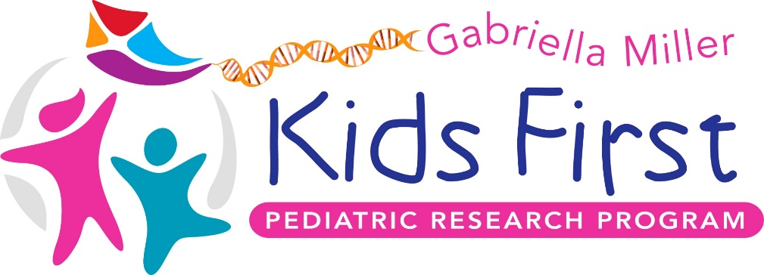
Alleviating Suffering from Childhood Cancer and Structural Birth Defects

Slide 16

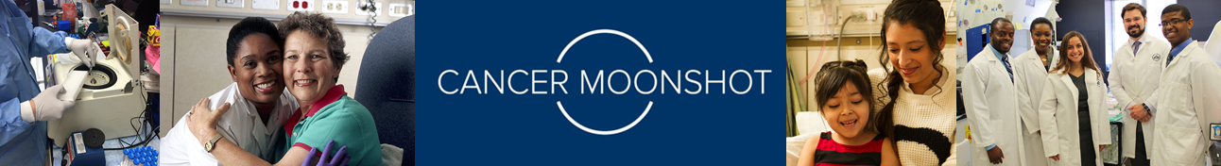

Slide 17
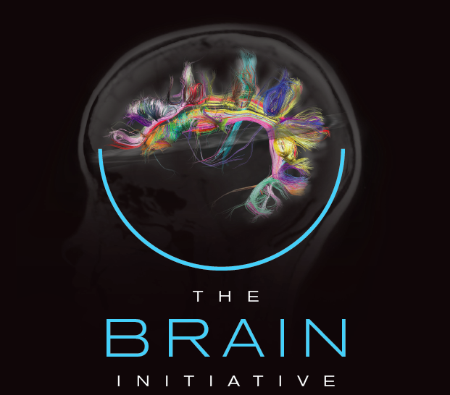

Slide 18


Slide 19


Wondros: If possible, we would love the rest of the slides to have the look & feel of this slide. Realize this may be too difficult in time allotted, but would love to move in this direction with this particular deck.
JoinAllofUs.org

Slide 20






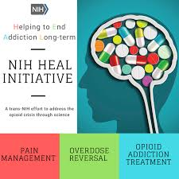

Envisioning a Future of Interconnected Data Sets
Framingham
Heart Study
…and many others!
SRA

Slide 21


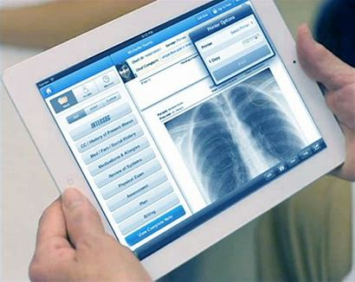
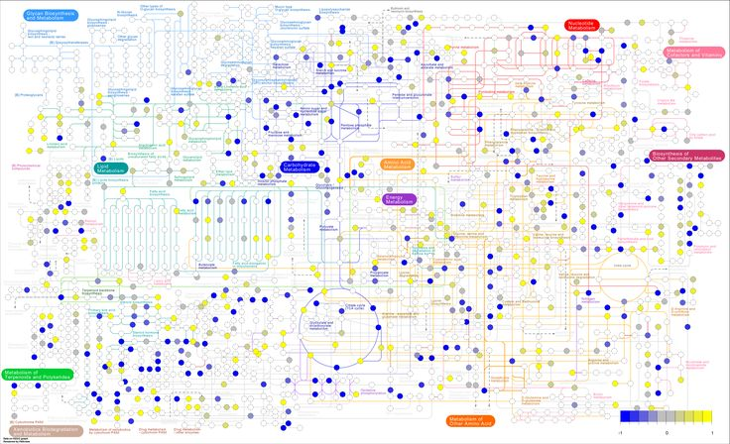
What will we discover when we can link individuals’ electronic health care records with their personal data, alongside clinical and basic research data?

Slide 22
NIH Cloud Platforms & Services

Slide 23
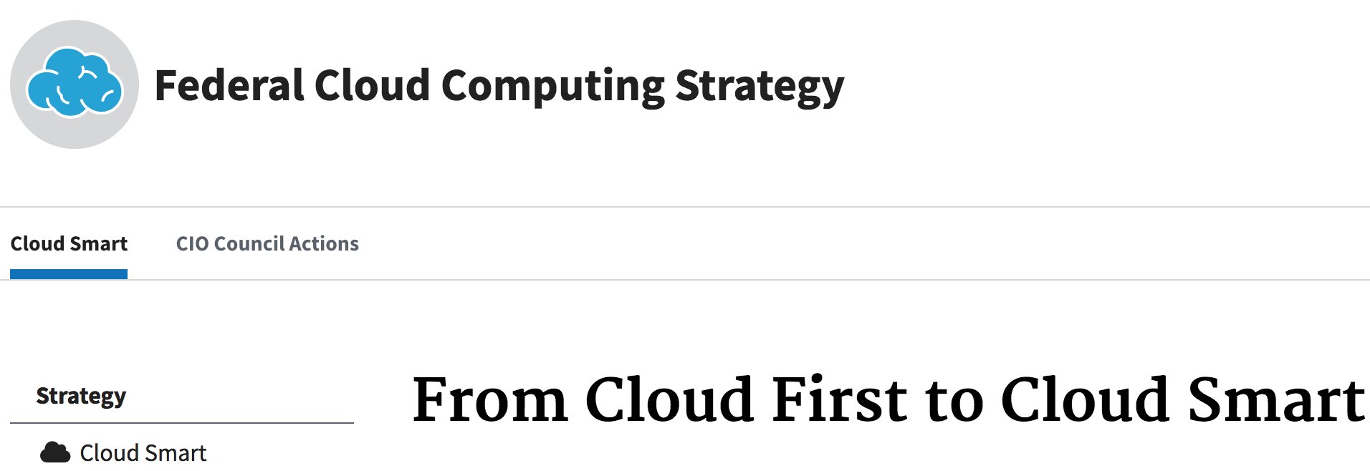
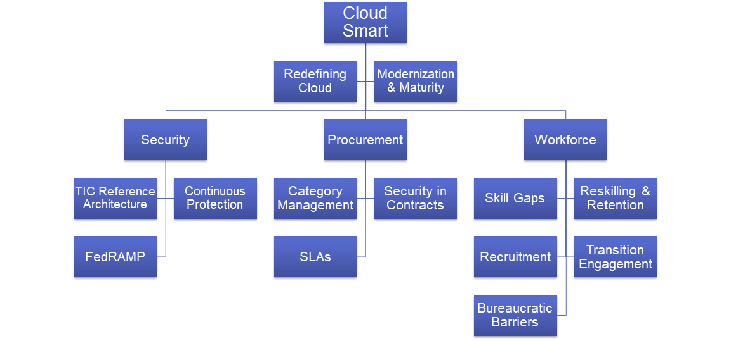
Some Context for Cloud Computing Within the Federal Government
https://cloud.cio.gov/strategy/

Slide 24
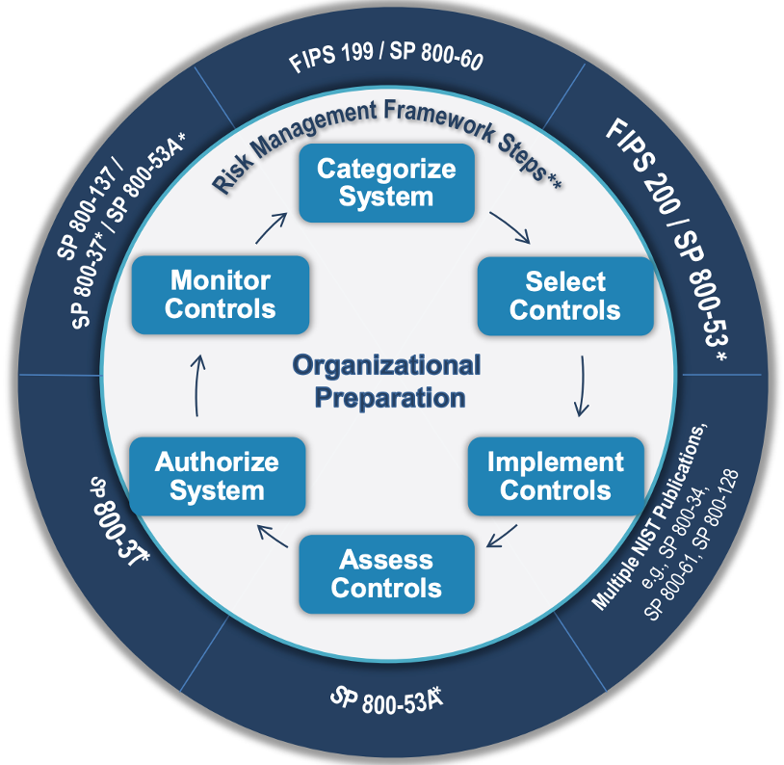
FISMA & FedRAMP
National Institute of Standards and Technology (NIST) outlines a Risk Management Framework for information systems
Federal Information Security Management Act (FISMA) requires federal systems to have authority to operate (ATO) to protect confidentiality, integrity, and availability of systems and data
Federal Risk and Authorization Management Program (FedRAMP) applies FISMA controls for cloud services, under a “authorize once and reuse many times” approach
3rd party assessments, with systems having current FedRAMP authorizations listed at https://marketplace.fedramp.gov/

Slide 25
NIH Cloud Smart Interest Group
Socialization and best practice sharing of cloud activities across NIH
Nearly 200 people, monthly meetings, online community resources (notes, document sharing, chat)
Formerly Cloud DevSecOps, membership includes research support personnel, enterprise IT staff, researchers, cybersecurity specialists, and others
Meeting topics vary based on group interests or timely activities
Cloud basics, use case review, adoption barriers, training opportunities, security challenges, governance approaches, guest presentations (e.g., on specific vendor offerings), etc.

Slide 26
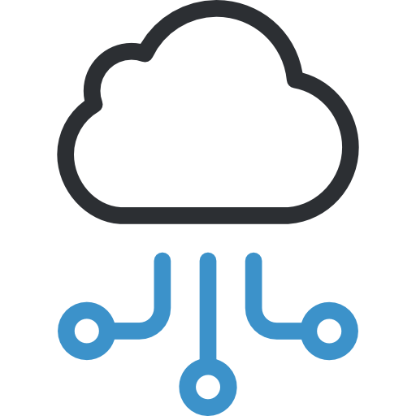




Operationalizing Cloud for NIH-Managed Data
Azure
Google Cloud
NIH
AWS
NIH
NIH
GOAL:
Progress
Robust cloud capabilities with standardized cybersecurity controls and extensive ATO inheritance
NIH
Federated NIH login and Identity and Access Management services
Secure, dedicated network connectivity from NIH to cloud platforms
Applied and inheritable cybersecurity controls and authority to operate (ATO)
Optimized cloud environments with assistance from cloud vendors

Slide 27


Service Layers
IC Selected and Managed Capabilities
Specific Cloud Services
Operating System
Applications
System Configuration
Data
Managed by ICs
NIH Shared Technology Services
NIH Identity & Access Management
Dedicated, High-speed Network Connections
NIH-wide Security Controls
Automation (e.g., Account Creation)
Reusable Templates & Runbooks
Managed by NIH
Cloud Infrastructure and Core Services
Global Regions & Availability Zones
Compute
Storage
Databases
Networking
Managed by CSP

Slide 28
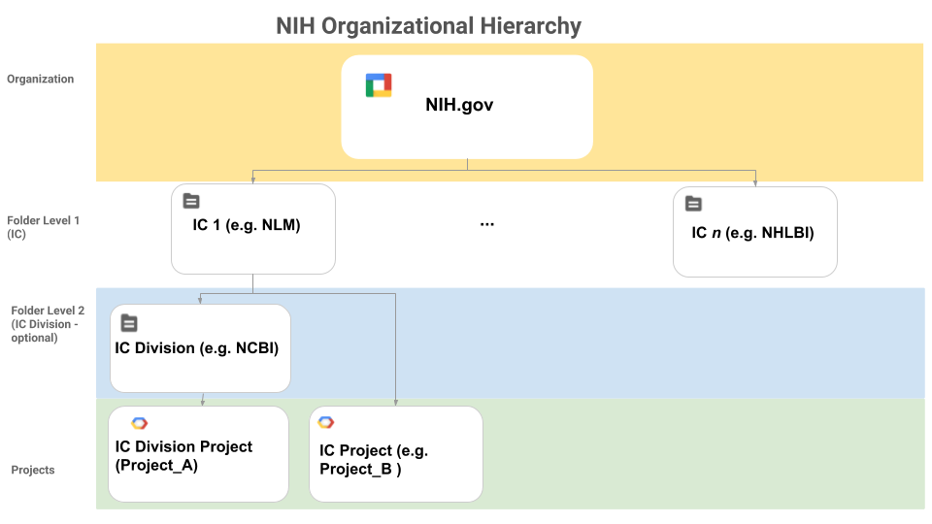
General Architecture
NIH-wide architecture standards
Single sign-on using NIH identities
High-speed, secure networking
Logging, monitoring, security controls
ATO on overall environment
NIH
IC-specific systems / applications / services
IC-specific technical and security controls
IC-specific management
NHGRI
NIMH
[Division, Lab, Etc.]
Project-specific systems / applications / services
Project-specific technical and security controls
Project-specific management
Project_1
Project_2
Notes:
Not NIH.gov, just NIH
Don’t mention governance (more talking about architectural standards) → NIH-wide architecture standards
High-speed, secure network connecting
Don’t use NLM as an example
Pick another one (NIMH, NHGRI)
Program → institute can establish the hierarchy however they want (intramural/extramural, org structure0
Color or put a box
Project-specific tools/systems/services
Project-specific technical or security controls
Project-specific management
Remove cost
Apartment building analogy
Franchise model

Slide 29
Funding Model
ICs directly fund their own compute, storage, and other services via STRIDES Other Transaction Agreements (OTA)
NIH Shared Technology Services
NIH Identity & Access Management
Dedicated, High-speed Network Connections
NIH-wide Security Controls
Automation (e.g., Account Creation)
Reusable Templates & Runbooks
Shared technology service costs are centrally funded

Slide 30
Shared Security Responsibility
STRIDES
STRIDES provides access to CSPs. CIT Cloud Services manages the Organization-level security, logging & monitoring, access control, and identities for STRIDES. ICs leverage STRIDES ATO and inherits appropriate security controls from GSS and child CSPs.
IC Application(s) & Project(s)
IC system owners and ISSOs leverages appropriate IC’s implemented security controls, STRIDES, NIH, and FedRAMP CSP controls. System owners and ISSOs are responsible for configuring their application for FISMA compliance, implementing any additional security controls that are system specific and those that are not inherited.
4
3
NIH & CIT Services
In collaboration with CIT IAM, Network Services, and NIH InfoSec, identified security controls that enable STRIDES and can be inherited by ICs.
2
CSP Infrastructure & Services
CSPs possess FedRAMP ATOs. NIH leverages the ATOs and inherits security controls for STRIDES. NIH/ICs are responsible for addressing controls that are not inherited.
1

Slide 31

Researcher and NIH Institute & Center Benefits
Security controls and guardrails
Consistent use of NIH identities and login credentials
IC funding and expense management, with NIH billing/payment service support
Dedicated, secure connectivity for data/file transfer
Monitoring and threat protection
Monthly reports and dashboard

Slide 32
Envisioning the Next Steps for Cloud at NIH

Slide 33
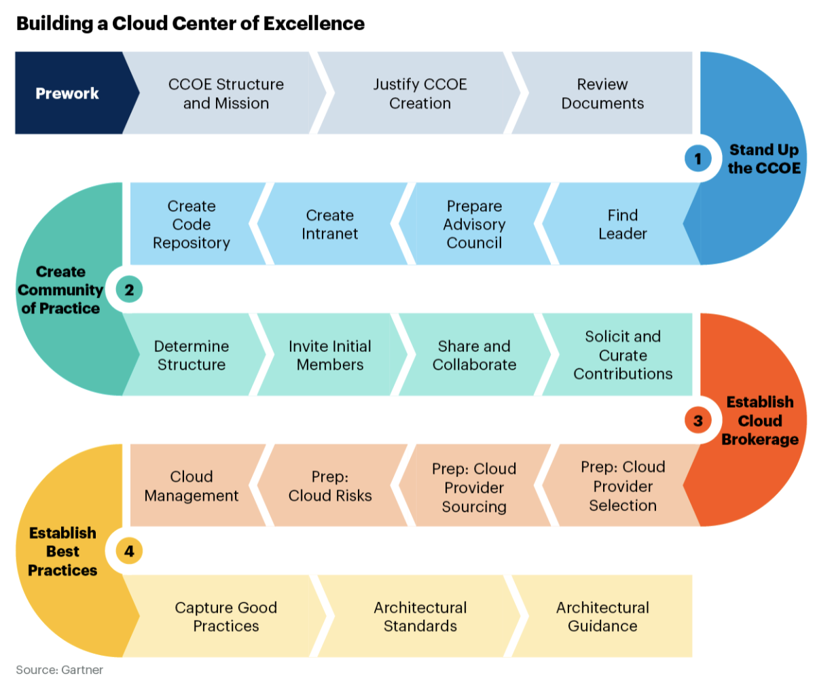
Capacity Building Approach
Establish NIH-wide governance and Cloud Center of Excellence, stemming from existing NIH Cloud Smart interest group
“Release” production-level, ATO’d cloud environments for NIH use; provision new and migrate existing cloud accounts/projects into these environments
Create, compile, and share best practices for doing research in the cloud
Develop targeted training programs for research and research support staff
Grow the team to focus on supporting the broader organization’s transition to cloud

Slide 34
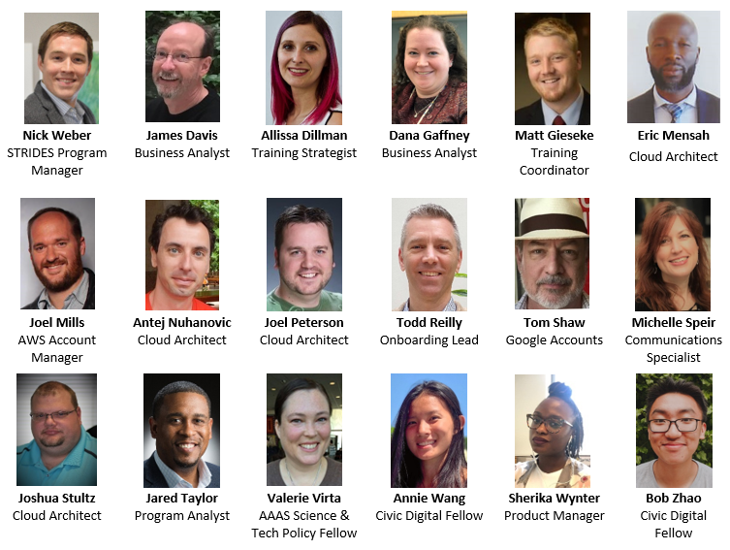
Acknowledgements
Oversight & Policy: Andrea Norris, Larry Tabak, Jim Anderson, Betsy Wilder, Susan Gregurick, Jess Mazerik, Taylor Gilliland, Belinda Seto, Michelle Bulls, Adam Graham
Negotiations & Awards Management: Kate O’Sullivan, Jeff Snyder, Teresa Marquette, Ann Gawalt, Chris Hammond, Kristin Wegner, Linda Shariati, Mike Steenstra, Jo Magnaye
Technology Advice: Vivien Bonazzi, Tony Kerlavage, Jim Ostell, Steve Sherry, Eugene Yashenko, Alastair Thomson
Communications: Jennifer Morgan Gray, Rachell Britt, Alexis Williams, Sisley Chung, Shira Weissman, Erin Walker
STRIDES Partners: Google, AWS, Carahsoft, Four Points Technology

Slide 35
Thank You!
General Contact:
STRIDES@nih.gov
Training Contact:
STRIDESTraining@nih.gov

